Slide 1
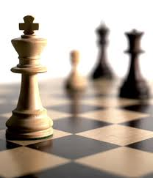


人工智能
罗平 luop@ict.ac.cn

Slide 2
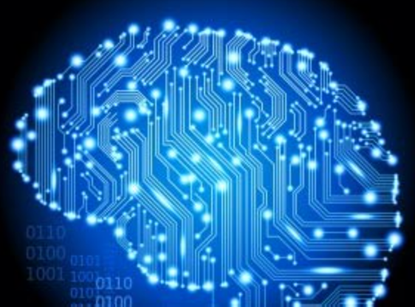
Knowledge 3

Slide 3
First-order Logic:
syntax and semantics

Slide 4
First-order logic
Whereas propositional logic assumes world contains facts, first-order logic(like natural language) assumes the world contains
Objects: people, house, numbers, theories, Ronald McDonald, colors, baseball games, wars, centuries…..
Relations: red, round, bogus, prime, multistoried…,
brother of, bigger than, inside, part of, has color, occurred after,
owns, comes between,…
Functions: father of, best friend, third inning of, one more than, end of…

Slide 5
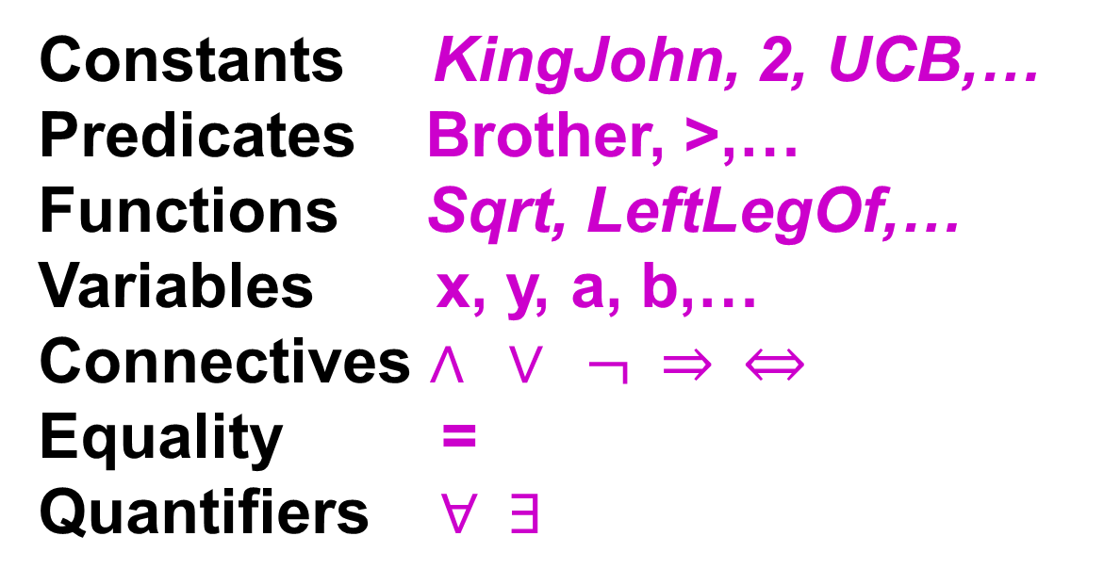
Syntax of FOL: Basic elements
Constants KingJohn, 2, UCB,…
Predicates Brother, >,…
Functions Sqrt, LeftLegOf,…
Variables x, y, a, b,…
Connectives $∧ ∨ ¬ ⇒ ⇔$
Equality =
Quantifiers $∀ ∃$

Slide 6
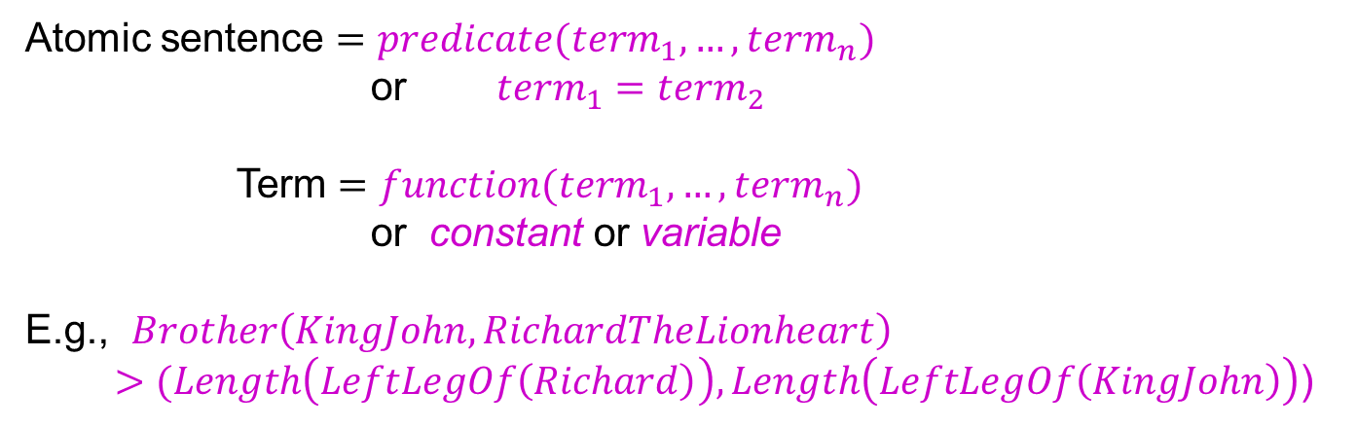
Atomic sentences
Atomic sentence $=predicate(term_{1},…,term_{n})$
or $term_{1}=term_{2}$
Term $=function(term_{1},…,term_{n})$
or constant or variable
E.g., $Brother\left(KingJohn, RichardTheLionheart\right)$
$>(Length\left(LeftLegOf\left(Richard\right)\right),Length\left(LeftLegOf\left(KingJohn\right)\right)$)

Slide 7
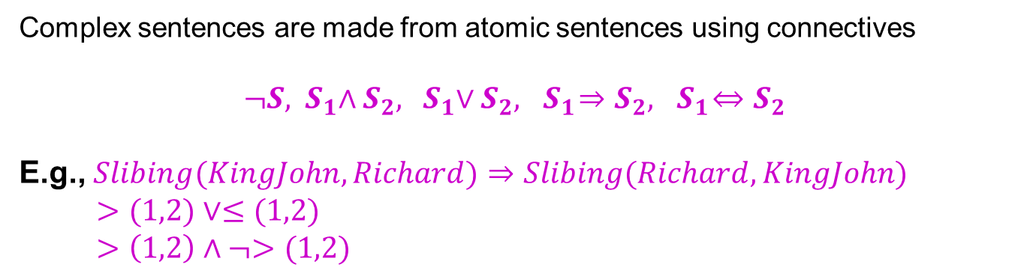
Complex sentences
Complex sentences are made from atomic sentences using connectives
$$¬S, { S}_{1}{∧S}_{2}, { S}_{1}∨S_{2}, { S}_{1}{⇒S}_{2},{ S}_{1}⇔S_{2}$$
E.g., $Slibing(KingJohn,Richard)⇒$ $Slibing(Richard,KingJohn)$
$>(1,2)∨≤(1,2)$
$>\left(1,2\right)∧¬>(1,2)$

Slide 8
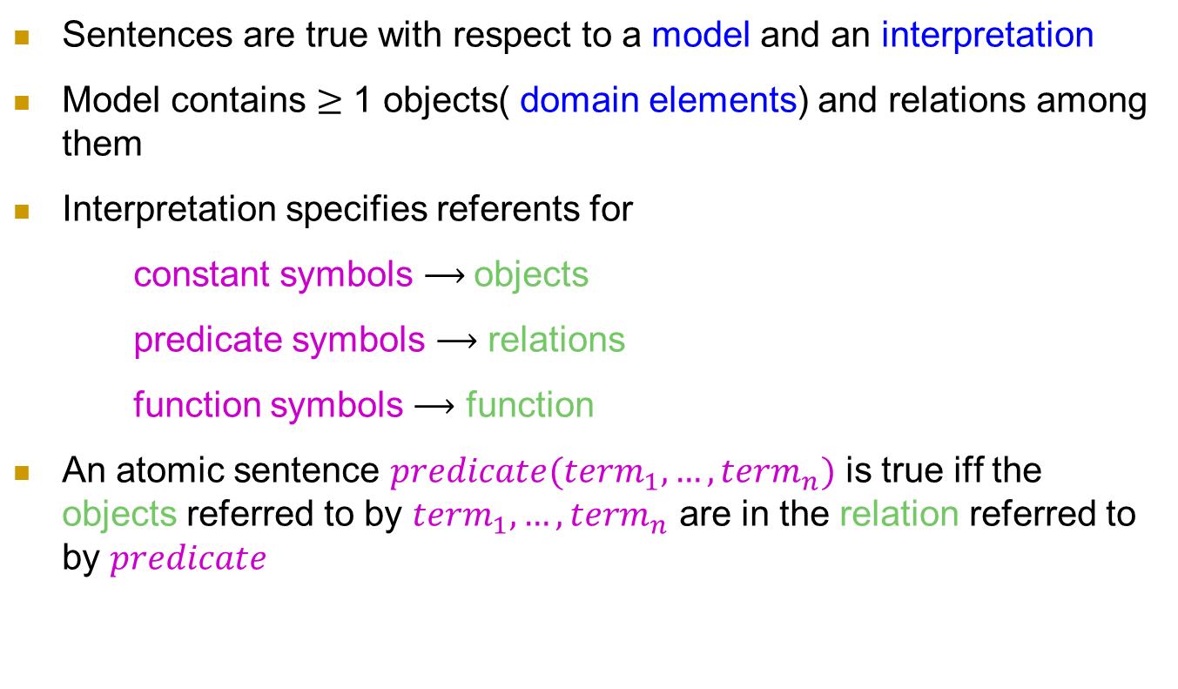
Truth in first-order logic
Sentences are true with respect to a model and an interpretation
Model contains $≥$ 1 objects( domain elements) and relations among them
Interpretation specifies referents for
constant symbols $⟶$objects
predicate symbols $⟶$ relations
function symbols $⟶$ function
An atomic sentence $predicate(term_{1},…,term_{n})$ is true iff the objects referred to by $term_{1},…,term_{n}$ are in the relation referred to by $predicate$
指示物

Slide 9
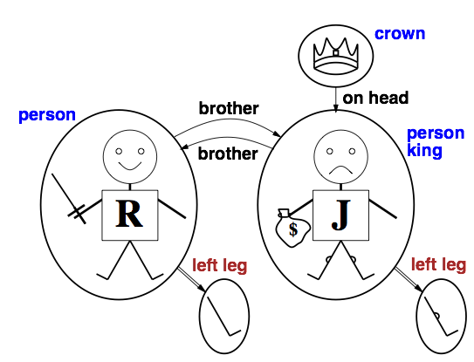
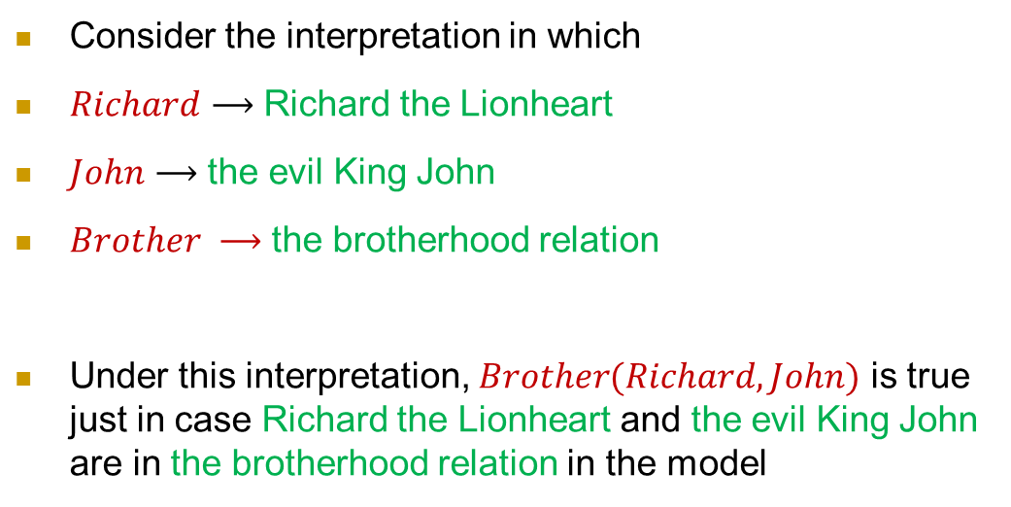
Models for FOL: Example
Consider the interpretation in which
$Richard⟶$ Richard the Lionheart
$John⟶$ the evil King John
$Brother ⟶$ the brotherhood relation
Under this interpretation, $Brother(Richard, John)$ is true just in case Richard the Lionheart and the evil King John are in the brotherhood relation in the model

Slide 10
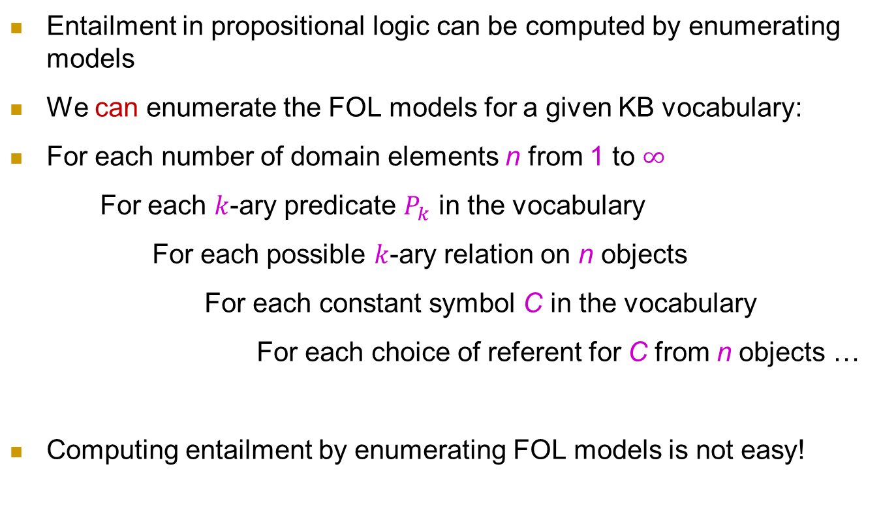
Models for FOL: Lots!
Entailment in propositional logic can be computed by enumerating models
We can enumerate the FOL models for a given KB vocabulary:
For each number of domain elements n from 1 to $∞$
For each $k$-ary predicate $P_{k}$ in the vocabulary
For each possible $k$-ary relation on n objects
For each constant symbol C in the vocabulary
For each choice of referent for C from n objects …
Computing entailment by enumerating FOL models is not easy!

Slide 11
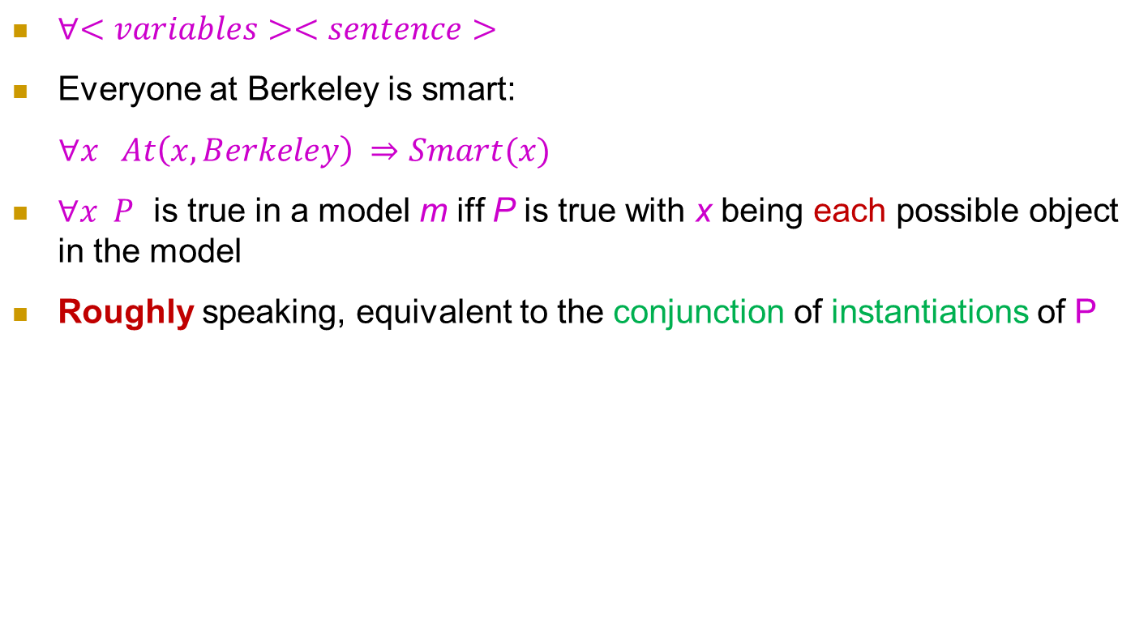
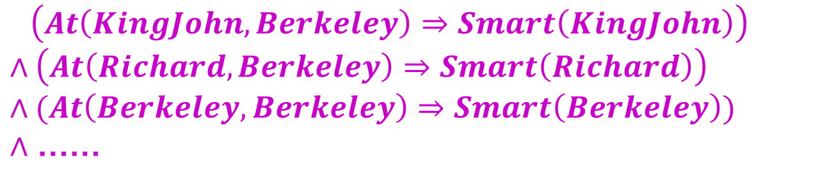
Universal quantification
$∀<variables><sentence>$
Everyone at Berkeley is smart:
$∀x At\left(x, Berkeley\right) ⇒Smart(x)$
$∀x P$ is true in a model m iff P is true with x being each possible object in the model
Roughly speaking, equivalent to the conjunction of instantiations of P
$\left(At\left(KingJohn,Berkeley\right)⇒Smart\left(KingJohn\right)\right)$
$∧\left(At\left(Richard,Berkeley\right)⇒Smart\left(Richard\right)\right)$
$∧(At\left(Berkeley,Berkeley\right)⇒Smart\left(Berkeley\right))$
$∧$ ……

Slide 12
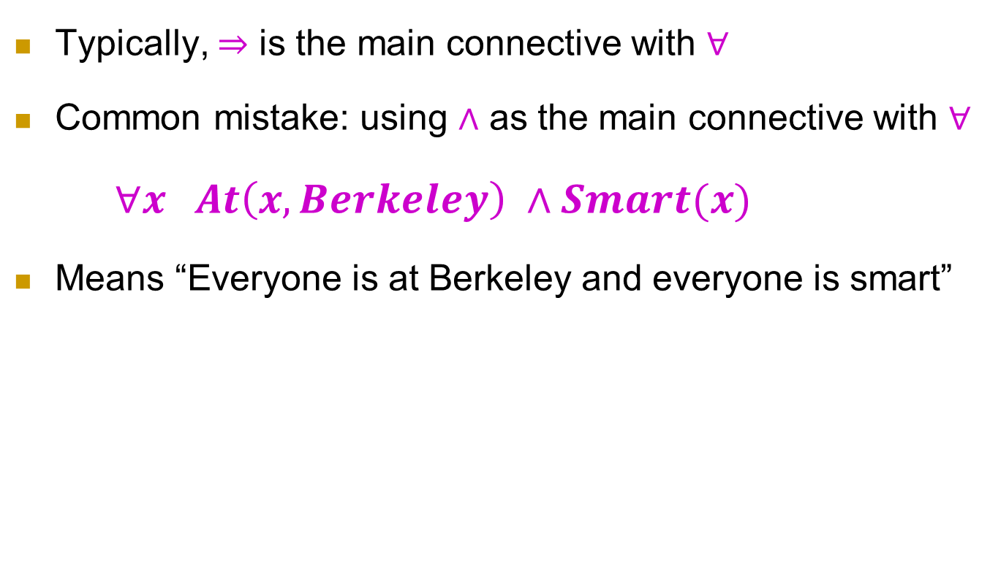
A common mistake to avoid
Typically, $⇒$ is the main connective with $∀$
Common mistake: using $∧$ as the main connective with $∀$
$∀x At\left(x, Berkeley\right) ∧Smart(x)$
Means “Everyone is at Berkeley and everyone is smart”

Slide 13
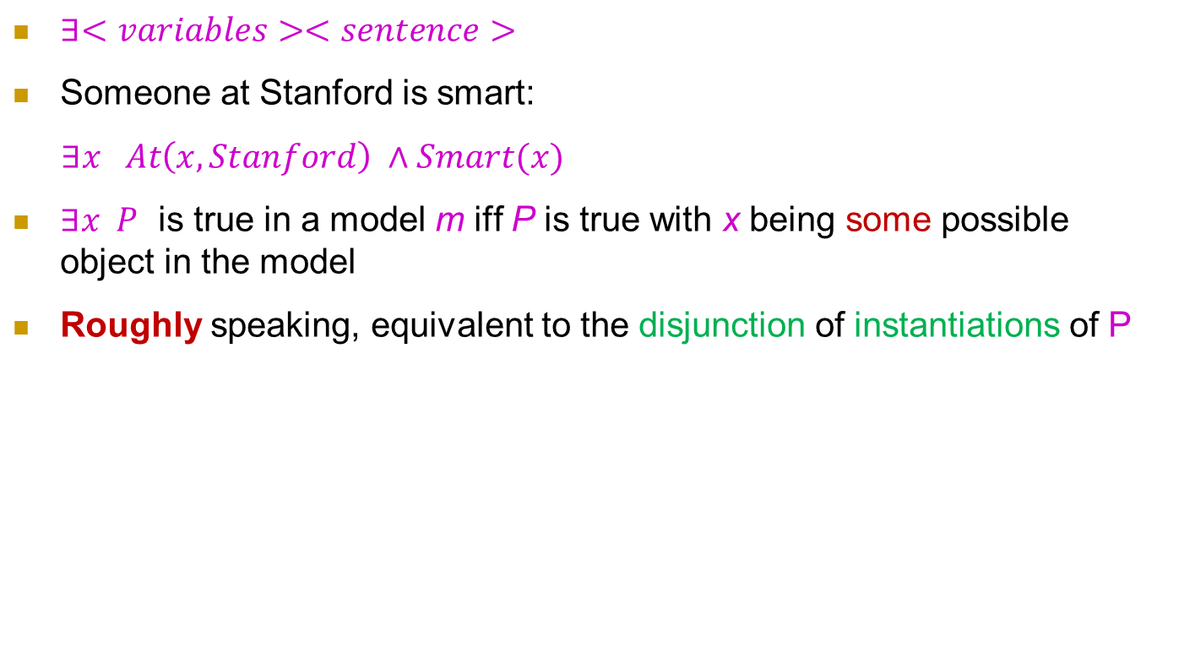
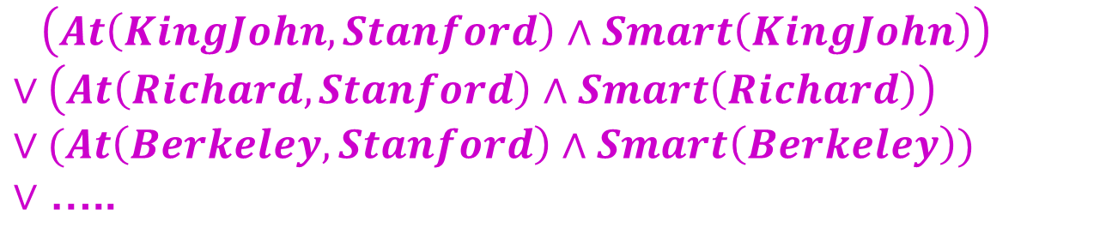
Existential quantification
$∃<variables><sentence>$
Someone at Stanford is smart:
$∃x At\left(x, Stanford\right) ∧Smart(x)$
$∃x P$ is true in a model m iff P is true with x being some possible object in the model
Roughly speaking, equivalent to the disjunction of instantiations of P
$\left(At\left(KingJohn,Stanford\right)∧Smart\left(KingJohn\right)\right)$
$∨\left(At\left(Richard,Stanford\right)∧Smart\left(Richard\right)\right)$
$∨(At\left(Berkeley,Stanford\right)∧Smart\left(Berkeley\right))$
$∨$ …..

Slide 14
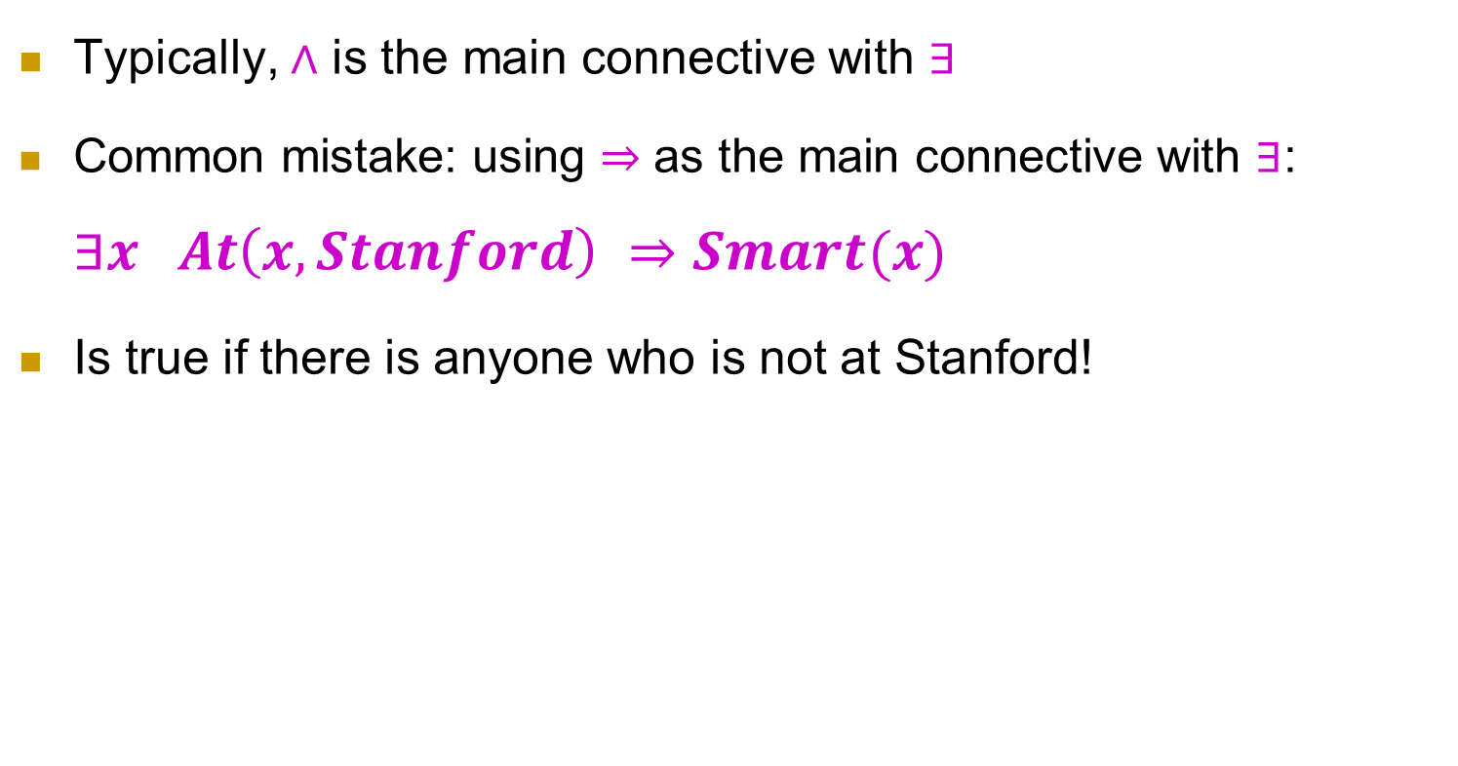
Another common mistake to avoid
Typically, $∧$ is the main connective with $∃$
Common mistake: using $⇒$ as the main connective with $∃$: $∃x At\left(x, Stanford\right) ⇒Smart(x)$
Is true if there is anyone who is not at Stanford!

Slide 15
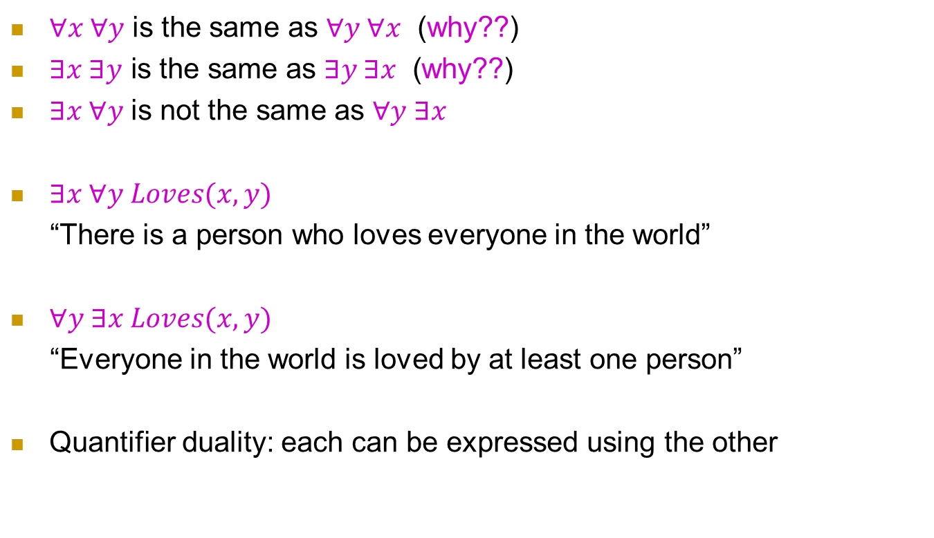
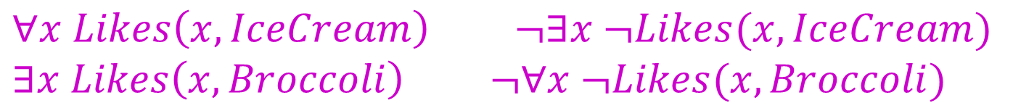
Properties of quantifiers
$∀x ∀y$ is the same as $∀y ∀x$ (why??)
$∃x ∃y \text{is} \text{the} \text{same} \text{as} ∃y ∃x \text{(}\text{why}\text{??)}$
$∃x ∀y$ is not the same as $∀y ∃x$
$∃x ∀y Loves(x,y)$
“There is a person who loves everyone in the world”
$∀y ∃x Loves(x,y)$
“Everyone in the world is loved by at least one person”
Quantifier duality: each can be expressed using the other
$∀x Likes\left(x,IceCream\right) ¬∃x ¬Likes(x,IceCream)$
$∃x Likes\left(x,Broccoli\right) ¬∀x ¬Likes(x,Broccoli)$

Slide 16
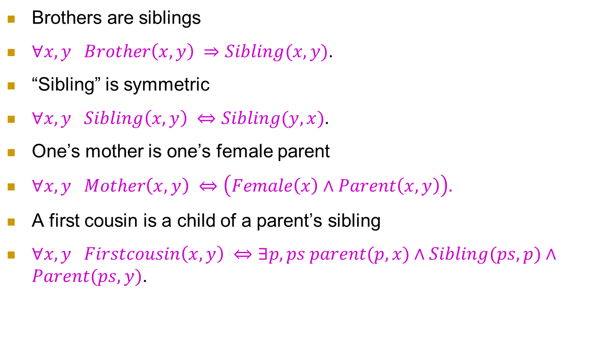
Fun with sentences
Brothers are siblings
$∀x,y Brother\left(x, y\right) ⇒Sibling(x,y)$.
“Sibling” is symmetric
$∀x,y Sibling\left(x, y\right) ⇔Sibling(y,x)$.
One’s mother is one’s female parent
$∀x,y Mother\left(x, y\right) ⇔\left(Female\left(x\right)∧Parent\left(x,y\right)\right).$
A first cousin is a child of a parent’s sibling
$∀x,y Firstcousin\left(x, y\right) ⇔∃p,ps parent(p,x)∧Sibling(ps,p)∧Parent(ps,y)$.

Slide 17
Fun with sentences
不到长城非好汉。
到了长城就是好汉。
理发师只给那些不给自己理发的人理发
理发师悖论

Slide 18
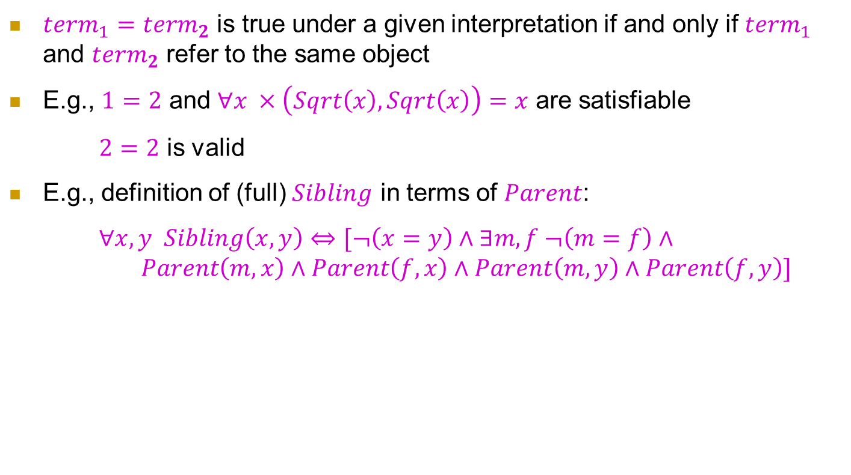
Equality
$term_{1}=term_{2}$ is true under a given interpretation if and only if $term_{1}$ and $term_{2}$ refer to the same object
E.g., $1=2$ and $∀x ×\left(Sqrt\left(x\right),Sqrt\left(x\right)\right)=x$ are satisfiable
$2=2$ is valid
E.g., definition of (full) $Sibling$ in terms of $Parent$:
$∀x,y Sibling\left(x,y\right)⇔[¬\left(x=y\right)∧∃m,f ¬\left(m=f\right)∧ Parent\left(m,x\right)∧Parent\left(f,x\right)∧Parent\left(m,y\right)∧Parent\left(f,y\right)]$

Slide 19
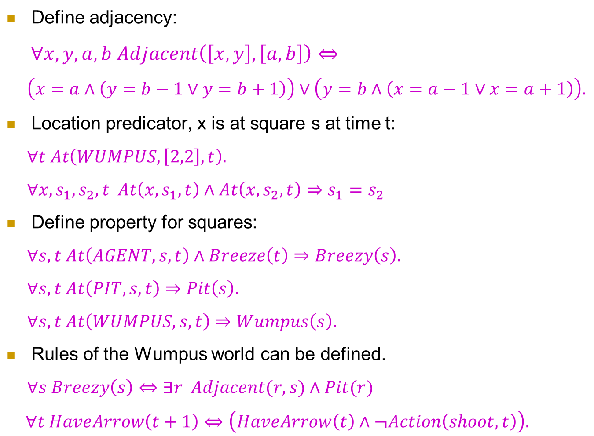
Back to the wumpus world again
Define adjacency:
$∀x,y,a,b Adjacent\left(\left[x,y\right],\left[a,b\right]\right)⇔$
$\left(x=a∧\left(y=b−1∨y=b+1\right)\right)∨\left(y=b∧\left(x=a−1∨x=a+1\right)\right).$
Location predicator, x is at square s at time t:
$∀t At\left(WUMPUS,\left[2,2\right],t\right).$
$∀x,s_{1},s_{2},t At\left(x,s_{1},t\right)∧At\left(x,s_{2},t\right)⇒s_{1}=s_{2}$
Define property for squares:
$∀s,t At\left(AGENT,s,t\right)∧Breeze\left(t\right)⇒Breezy\left(s\right).$
$∀s,t At\left(PIT,s,t\right)⇒Pit\left(s\right).$
$∀s,t At\left(WUMPUS,s,t\right)⇒Wumpus\left(s\right).$
Rules of the Wumpus world can be defined.
$∀s Breezy\left(s\right)⇔∃r Adjacent(r,s)∧Pit(r)$
$∀t HaveArrow\left(t+1\right)⇔\left(HaveArrow\left(t\right)∧¬Action\left(shoot,t\right)\right).$

Slide 20
Short Summary
First-order logic:
Objects and relations are semantic primitives
Syntax: constants, functions, predicates, equality, quantifiers
Increased expressive power: sufficient to define Wumpus world

Slide 21
First-Order Logic: Inference
Propositionalization

Slide 22
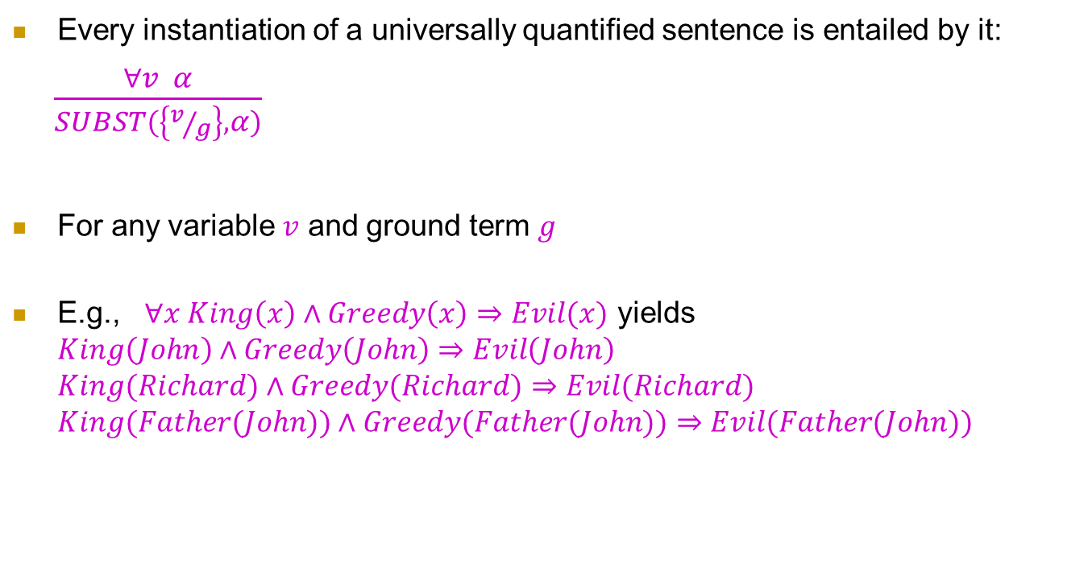
Universal Instantiation (UI)
Every instantiation of a universally quantified sentence is entailed by it:
$\frac{∀v α}{SUBST(\left\{v/g\right\},α)}$
For any variable $v$ and ground term $g$
E.g., $∀x King\left(x\right)∧Greedy\left(x\right)⇒Evil(x)$ yields $King\left(John\right)∧Greedy\left(John\right)⇒Evil\left(John\right)$ $King(Richard)∧Greedy(Richard)⇒Evil(Richard)$ $King(Father(John))∧Greedy(Father(John))⇒Evil(Father(John))$

Slide 23
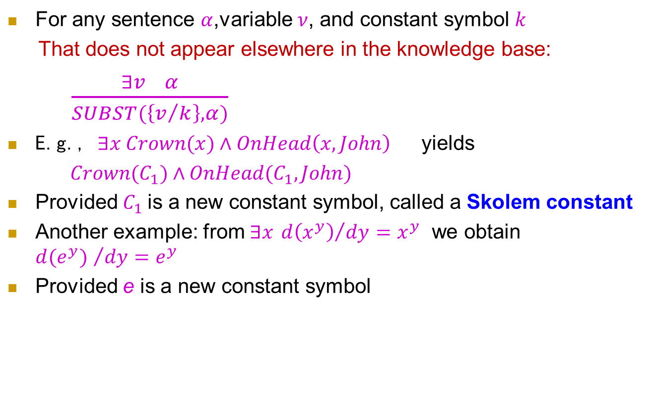
Existential Instantiation (EI)
For any sentence $α$,variable $ν$, and constant symbol $k$
That does not appear elsewhere in the knowledge base:
$\frac{∃v α}{SUBST(\left\{v/k\right\},α)}$
E.g., $∃x Crown(x)∧OnHead\left(x,John\right)$ yields
$Crown(C_{1})∧OnHead(C_{1},John)$
Provided $C_{1}$is a new constant symbol, called a Skolem constant
Another example: from $∃x {d\left(x^{y}\right)}/{dy}=x^{y}$ we obtain ${d(e^{y}) }/{dy=e^{y}}$
Provided e is a new constant symbol

Slide 24
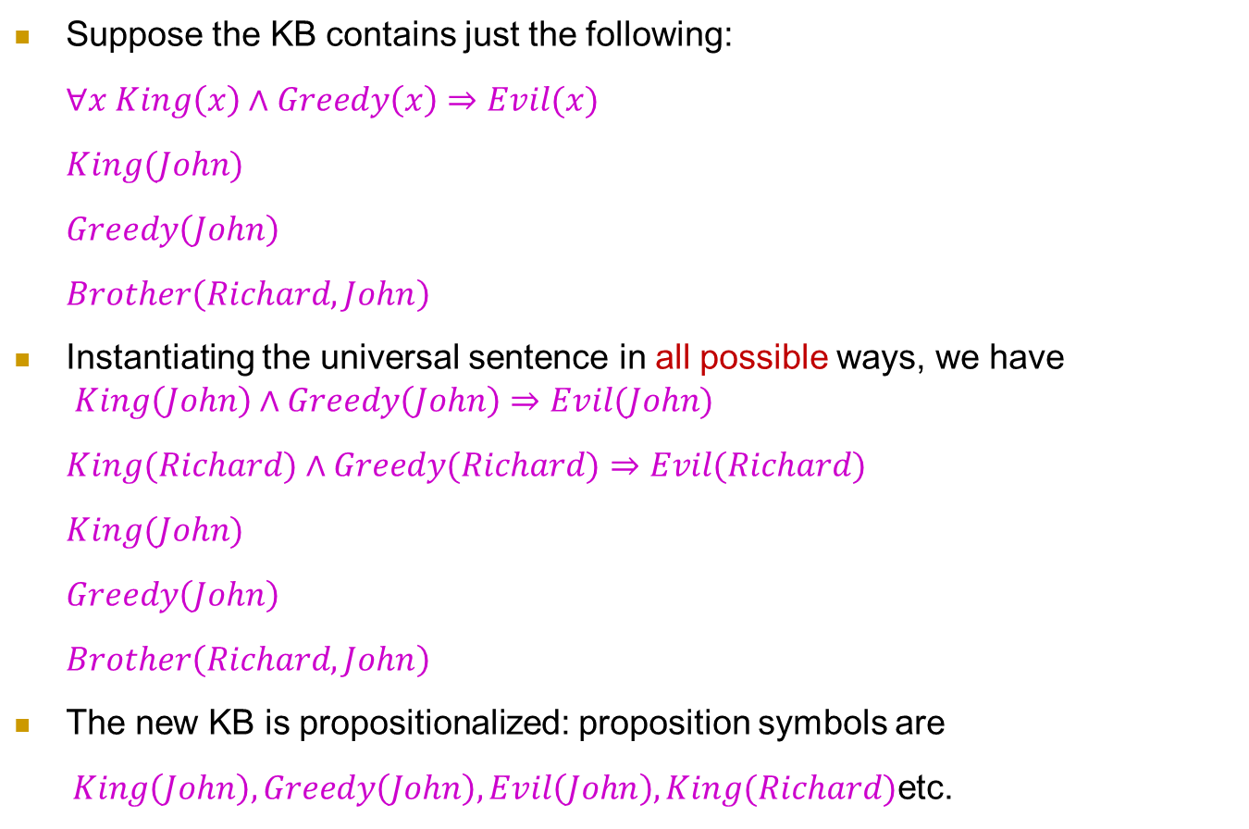
Reduction to propositional inference
Suppose the KB contains just the following:
$∀x King\left(x\right)∧Greedy\left(x\right)⇒Evil(x)$
$King(John)$
$Greedy\left(John\right)$
$Brother\left(Richard,John\right)$
Instantiating the universal sentence in all possible ways, we have $King\left(John\right)∧Greedy\left(John\right)⇒Evil(John)$
$King(Richard)∧Greedy(Richard)⇒Evil(Richard)$
$King(John)$
$Greedy\left(John\right)$
$Brother\left(Richard,John\right)$
The new KB is propositionalized: proposition symbols are
$King\left(John\right),Greedy\left(John\right),Evil\left(John\right),King(Richard)$etc.

Slide 25
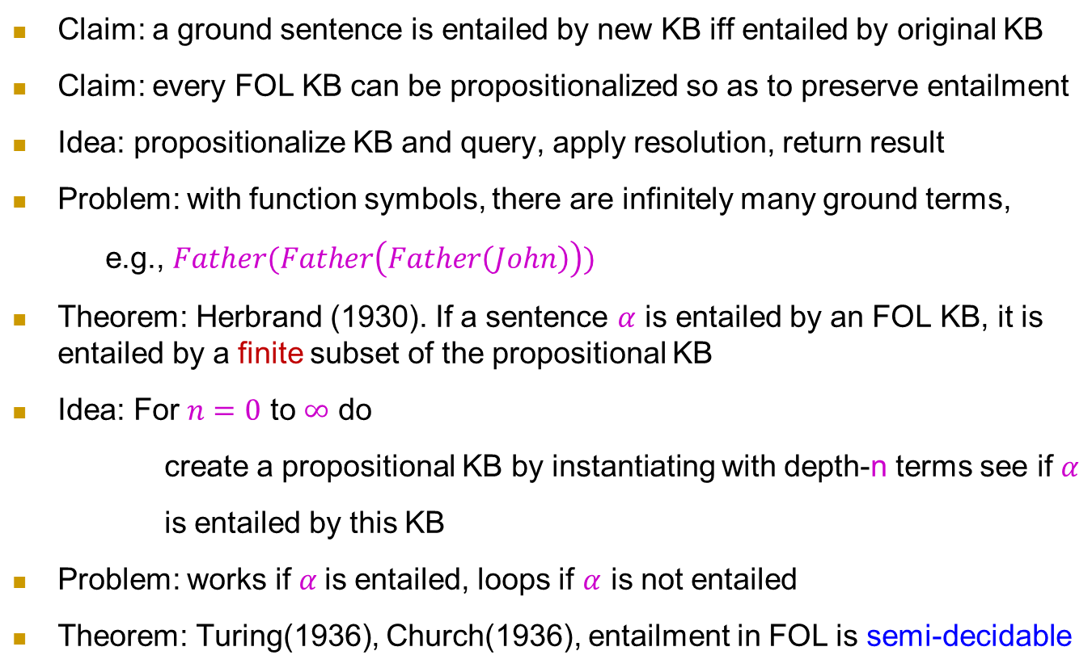
Reduction to propositional inference
Claim: a ground sentence is entailed by new KB iff entailed by original KB
Claim: every FOL KB can be propositionalized so as to preserve entailment
Idea: propositionalize KB and query, apply resolution, return result
Problem: with function symbols, there are infinitely many ground terms,
e.g., $Father(Father\left(Father\left(John\right)\right))$
Theorem: Herbrand (1930). If a sentence $α$ is entailed by an FOL KB, it is entailed by a finite subset of the propositional KB
Idea: For $n=0$ to $∞$ do
create a propositional KB by instantiating with depth-n terms see if $α$
is entailed by this KB
Problem: works if $α$is entailed, loops if $α$ is not entailed
Theorem: Turing(1936), Church(1936), entailment in FOL is semi-decidable

Slide 26
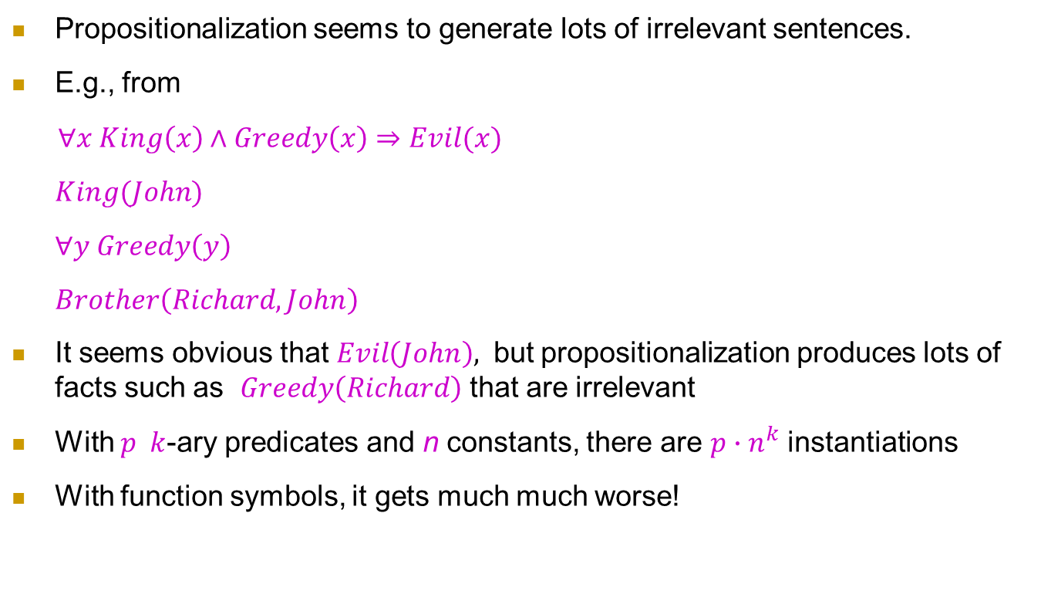
Problems with Propositionalization
Propositionalization seems to generate lots of irrelevant sentences.
E.g., from
$∀x King\left(x\right)∧Greedy\left(x\right)⇒Evil(x)$
$King(John)$
$∀y Greedy\left(y\right)$
$Brother\left(Richard,John\right)$
It seems obvious that $Evil\left(John\right),$ but propositionalization produces lots of facts such as $Greedy\left(Richard\right)$ that are irrelevant
With $p k$-ary predicates and n constants, there are $p∙n^{k}$ instantiations
With function symbols, it gets much much worse!

Slide 27
研究形式逻辑的目的是什么？
知识表示
将一组知识形式化为符号
知识推理
通过形式推演，自动推出结论
可靠
完备

Slide 28
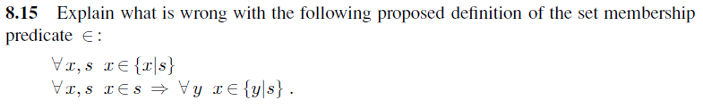
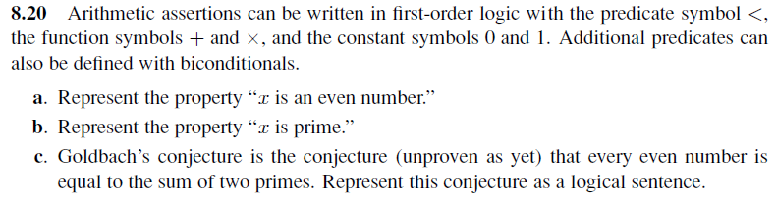
Homework

